Slide 1
MongoDB CRUD Operations
Gunar Ortiz

Slide 2



fb.me/gunar.ortiz
github.com/gunarortiz
medium.com/@golofaz

Slide 3


Slide 4
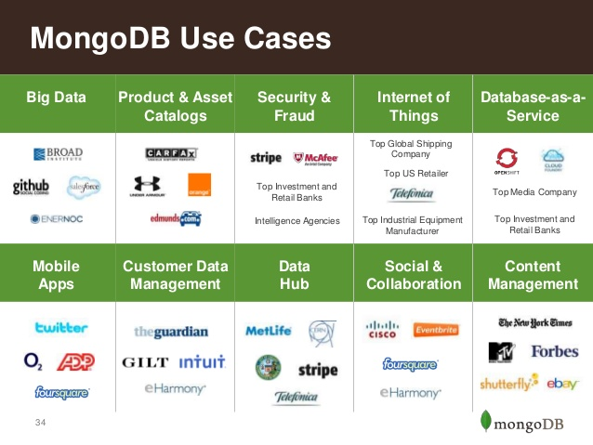

Slide 5
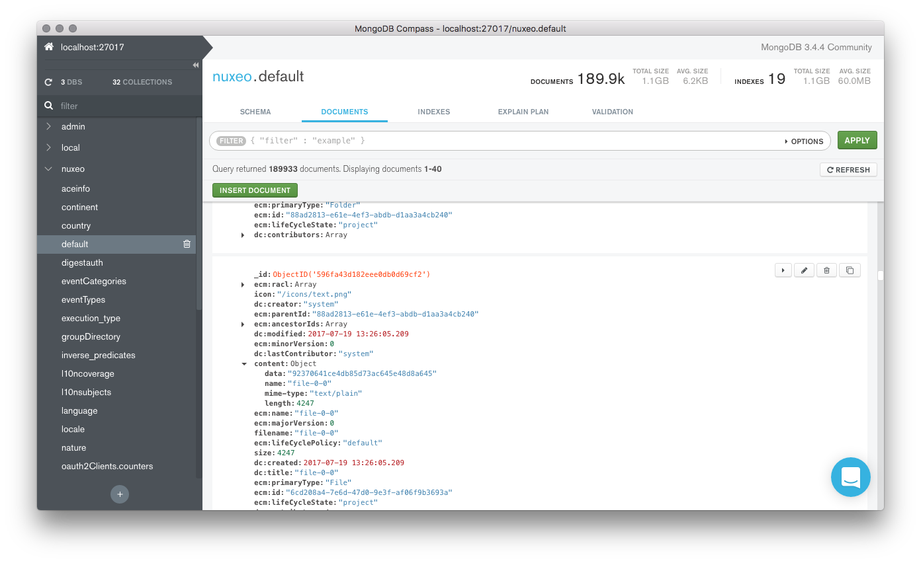

Slide 6
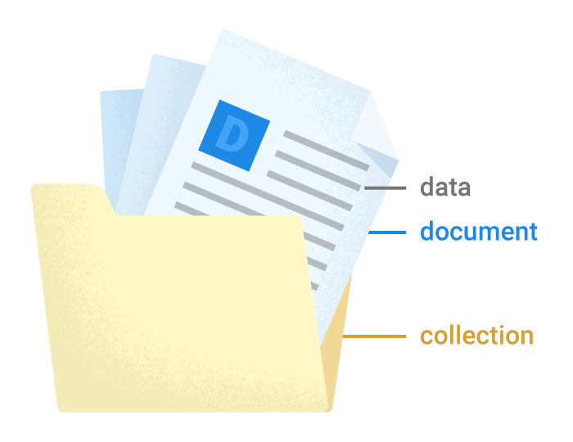

Slide 7
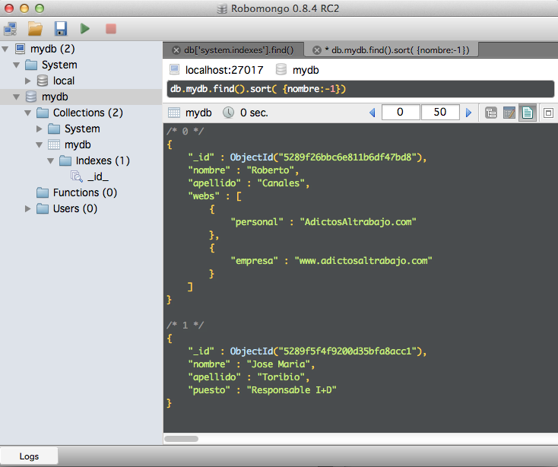

Slide 8
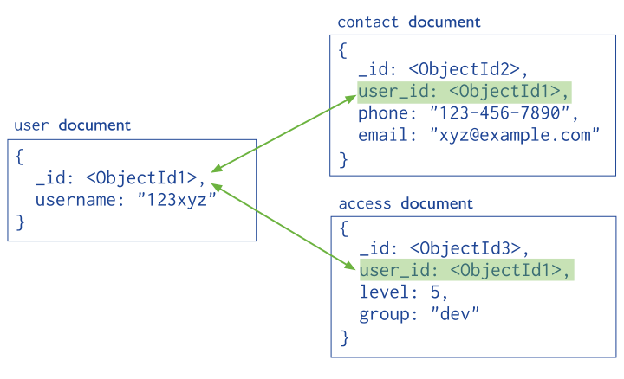

Slide 9
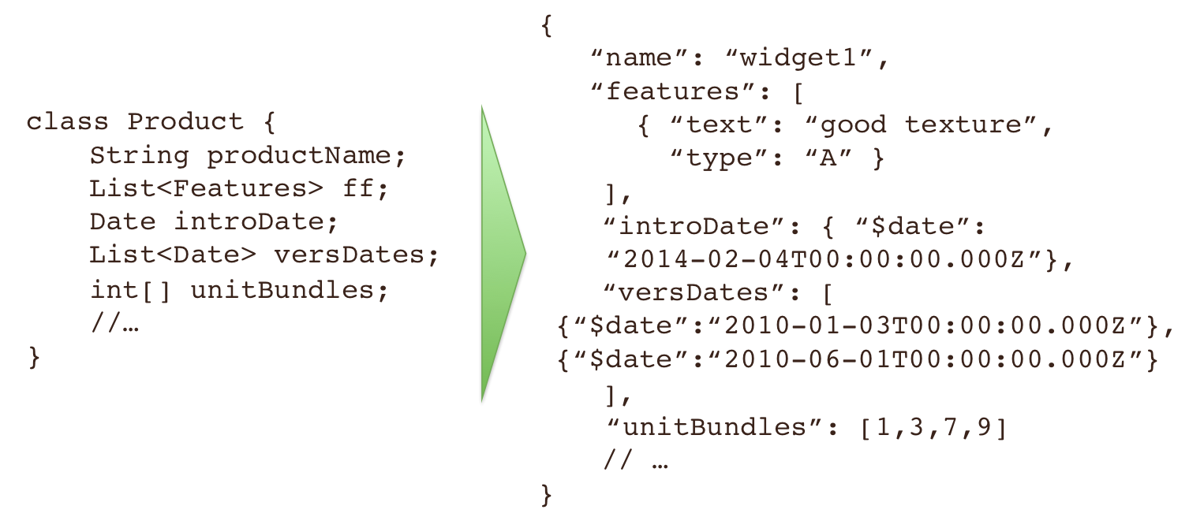

Slide 10


Slide 11
INSERT
FIND
UPDATE
REMOTE

Slide 12
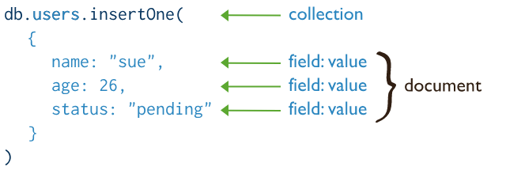
Create Operations

Slide 13
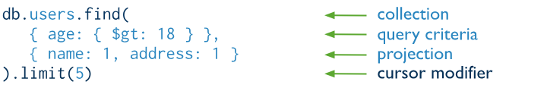
Read Operations

Slide 14
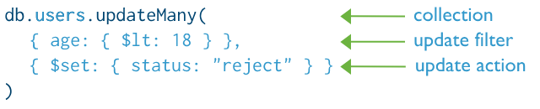
Update Operations

Slide 15
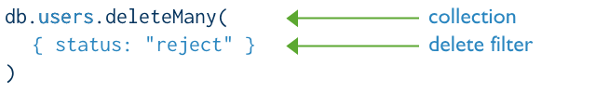
Delete Operations

Slide 16


Slide 17
fb.me/gunar.ortiz
github.com/gunarortiz
medium.com/@golofaz

